Slide 1
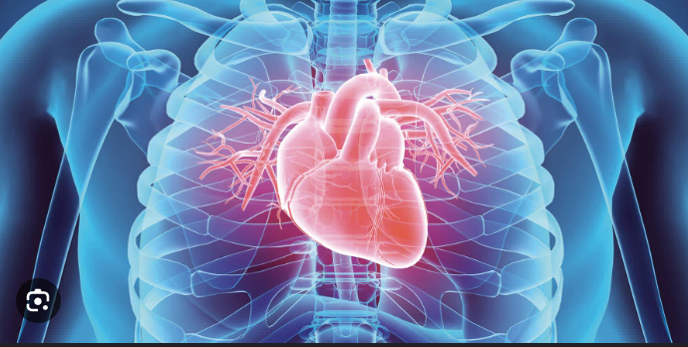
Heart Disease Analysis in India
Members:
Nirnay Awasthi
Aditi Pandey
Aditi Agnihotri
Anshika Dubey
Ishita Agarwal
Shashank Mishra
Shivam Dubey
Suryakant Mishra
Vanshika Gupta

Slide 2

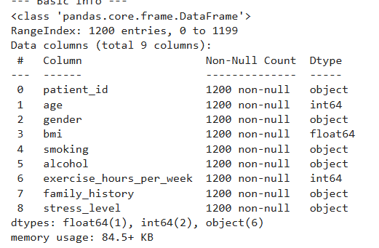
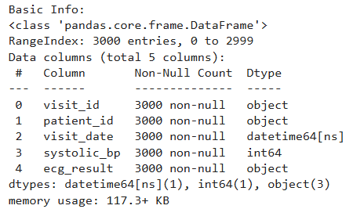
Dataset Overview
Patients.csv
Visits.csv

Slide 3

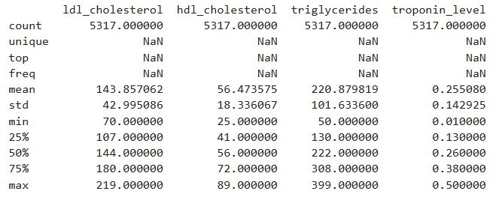
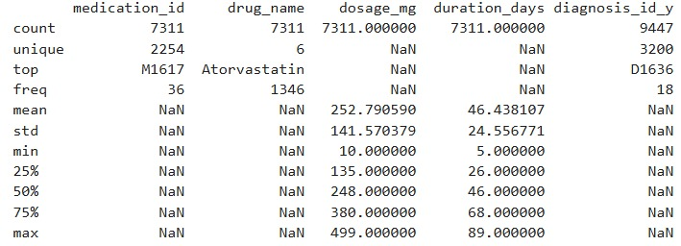
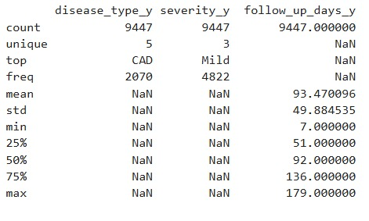
Dataset Overview
Diagnosis.csv
Medication.csv
Lab_Record.csv

Slide 4

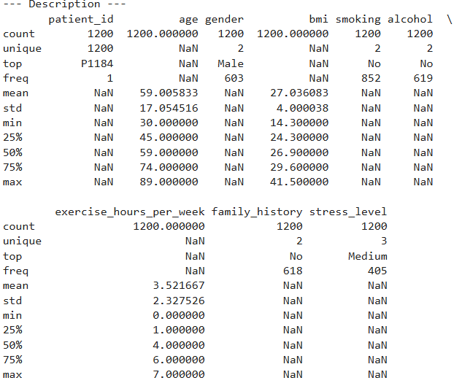
Patient Data Analysis

Slide 5

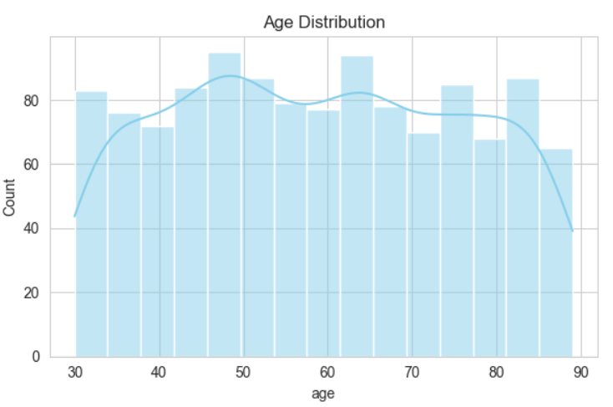
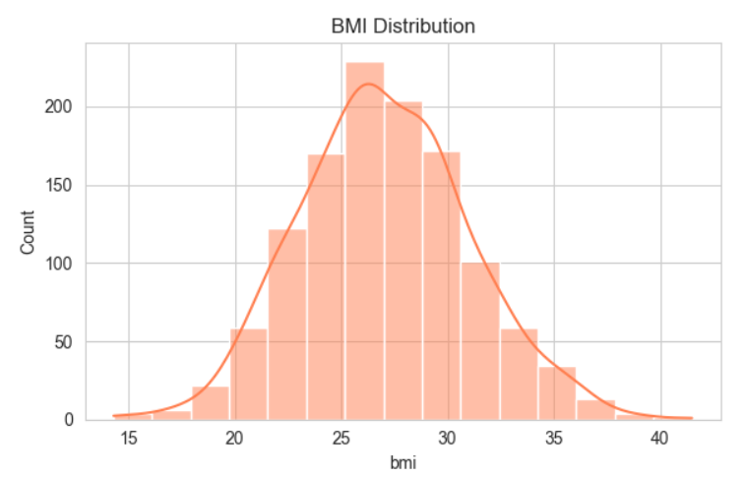
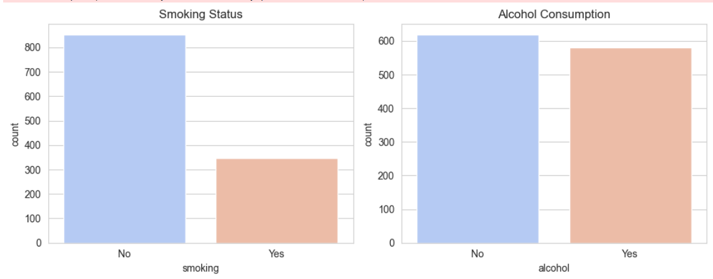
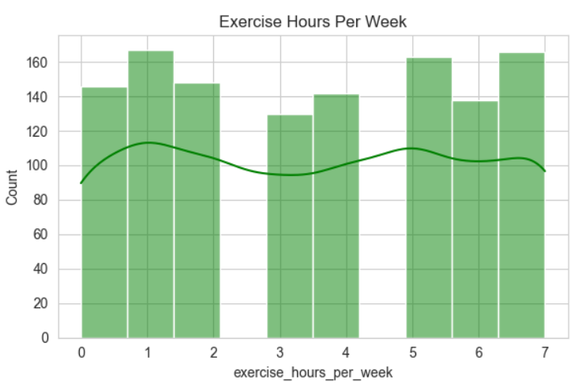
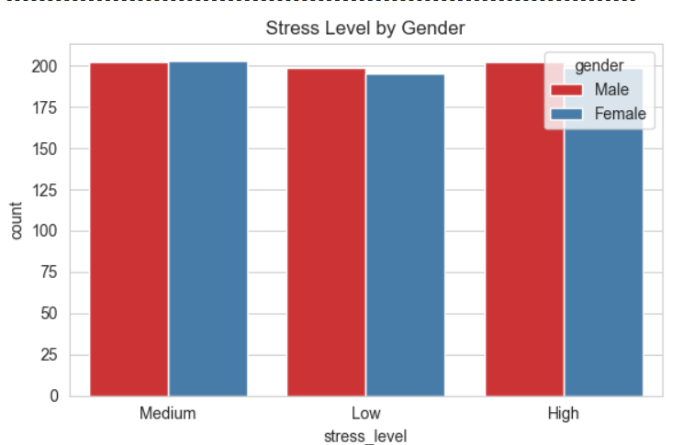
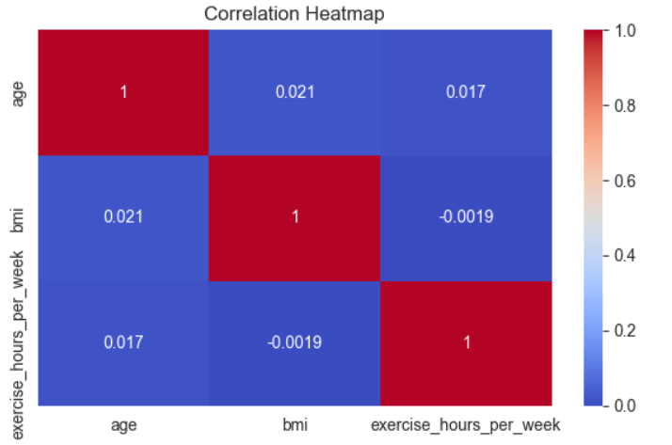
Patient Data Analysis(Visualization)

Slide 6

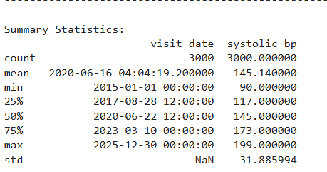
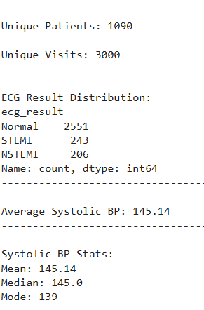
Visit Data Analysis

Slide 7

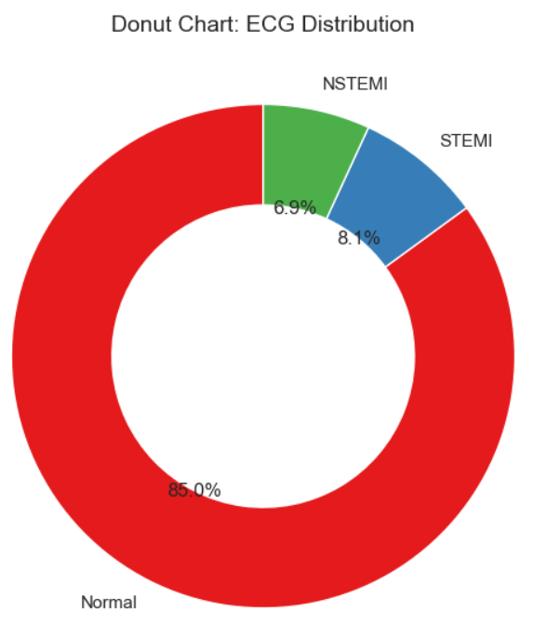
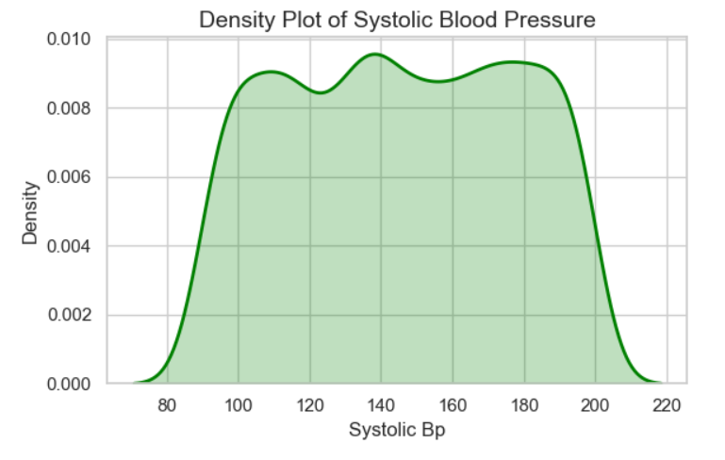
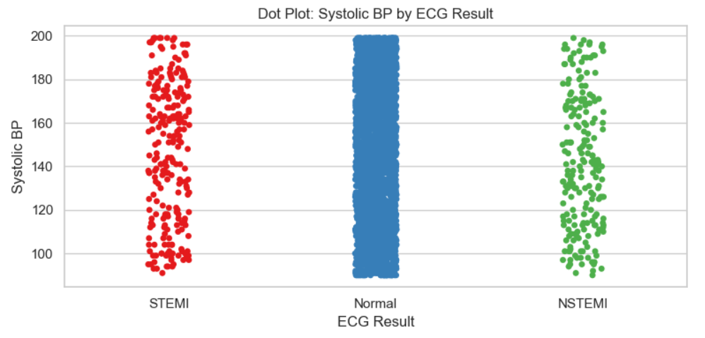
Visit Data Analysis(Visualization)

Slide 8
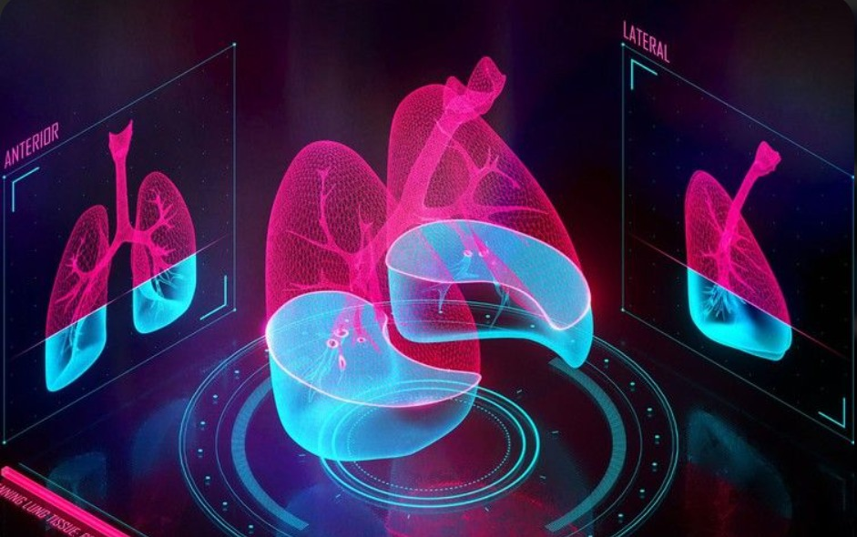
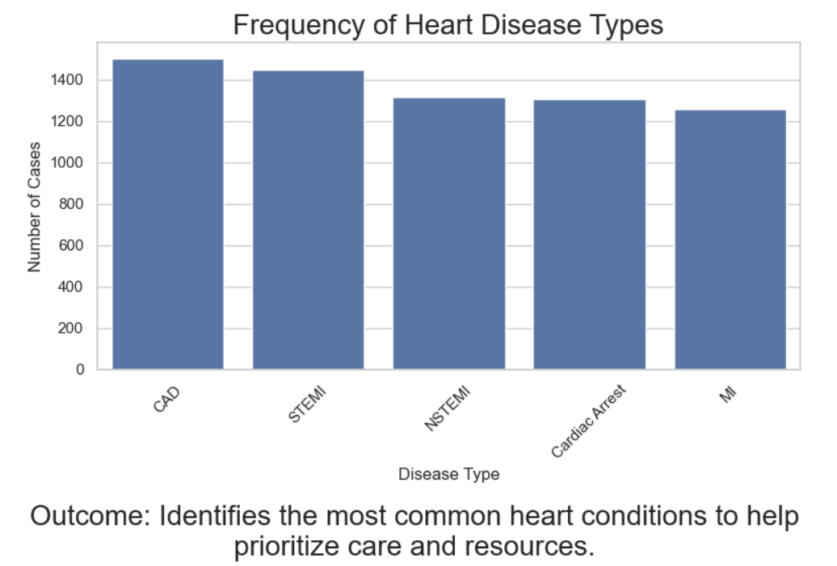
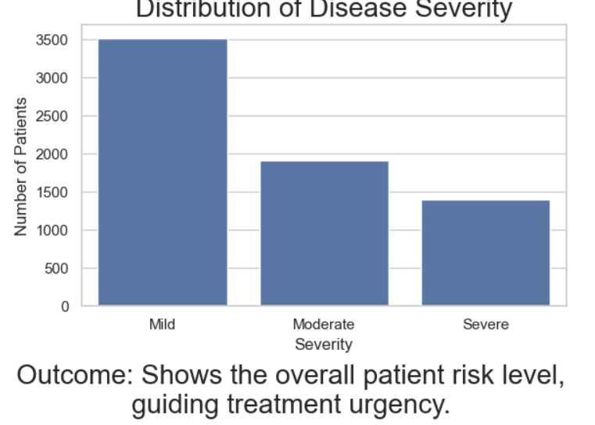
Lab_result + Medication + Diagnoses

Slide 9

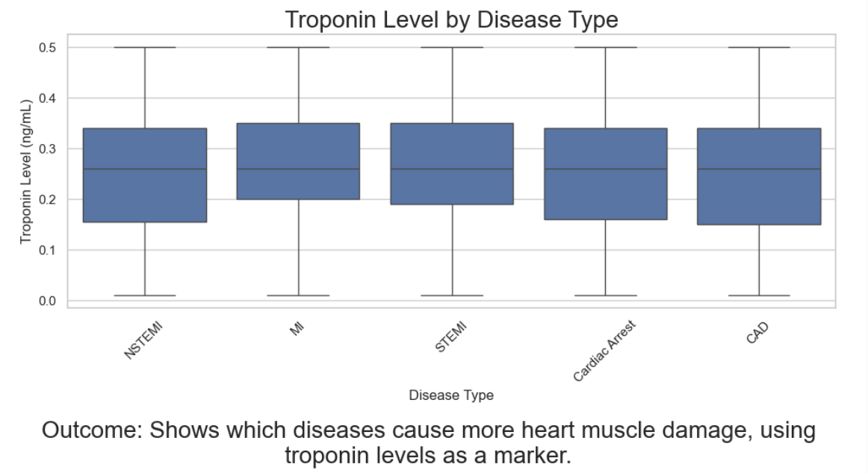
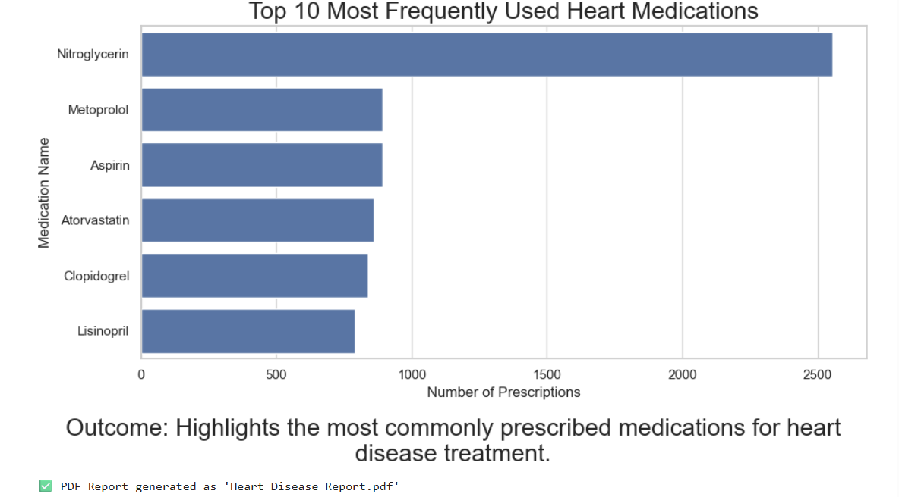

Slide 10
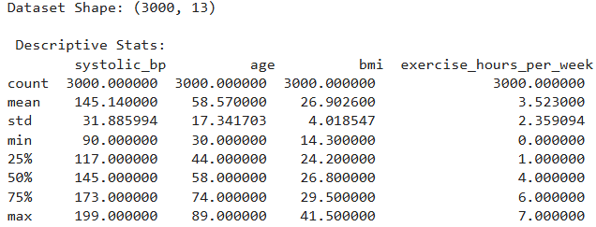
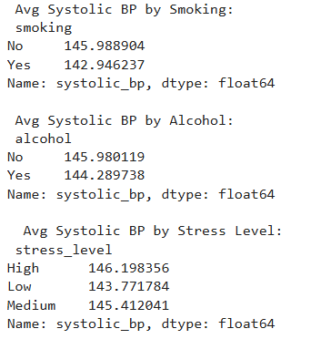
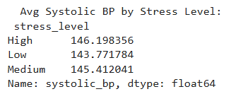
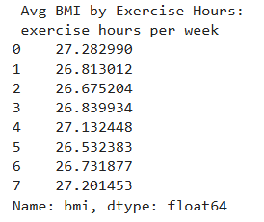
Joint Analysis: Patients + Visits

Slide 11
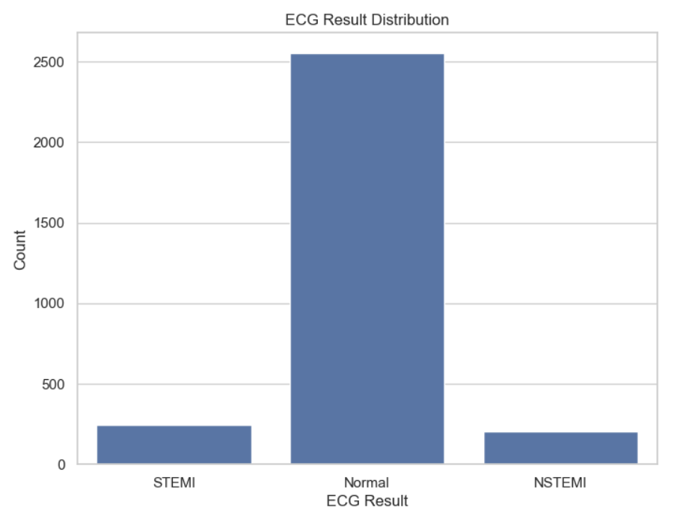
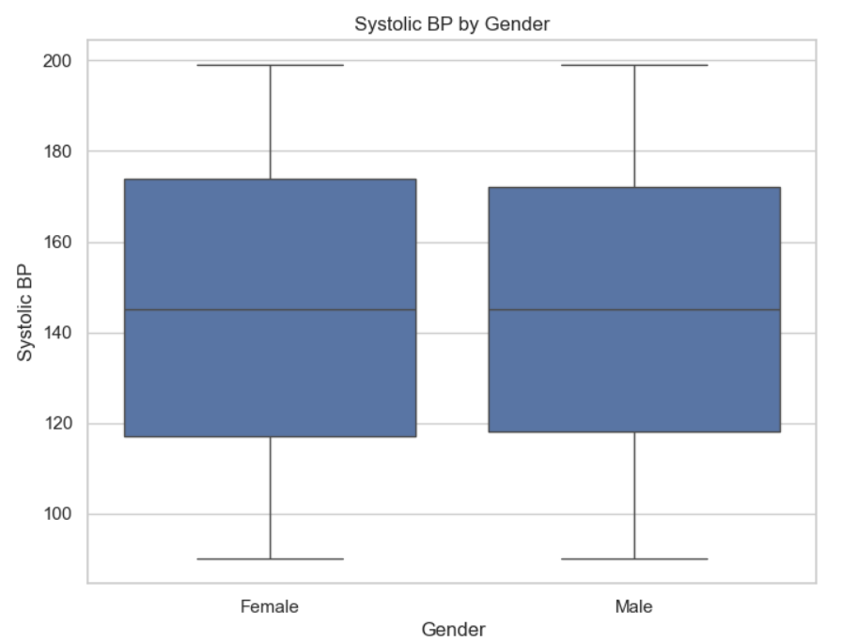
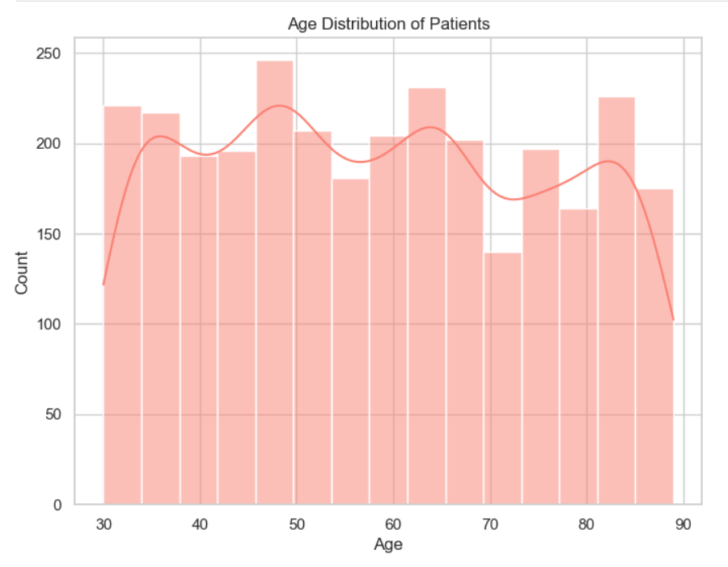
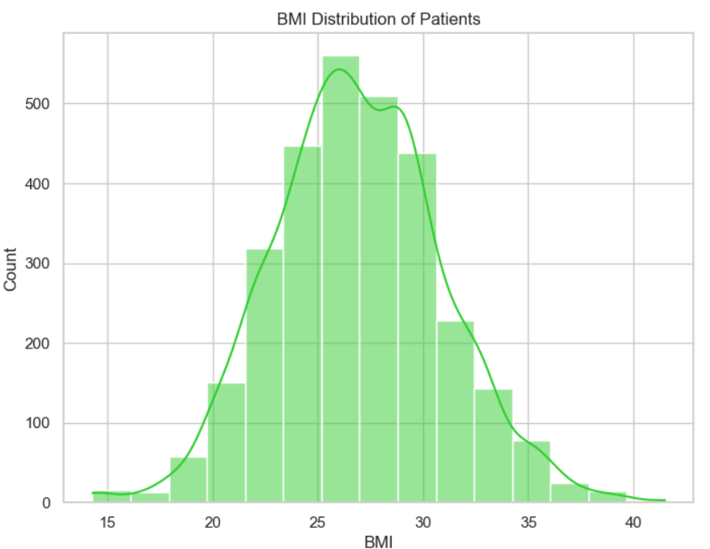
Joint Analysis: Patients + Visits

Slide 12
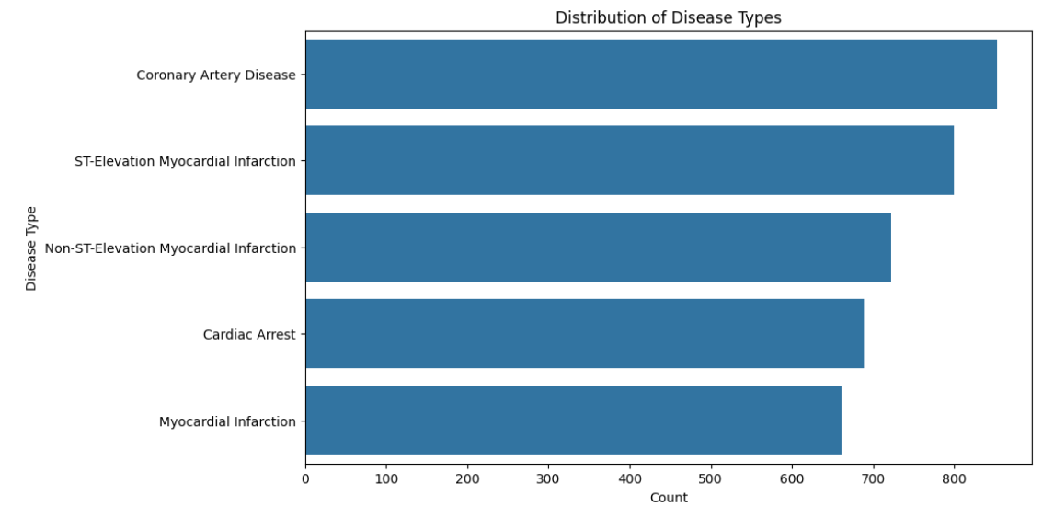
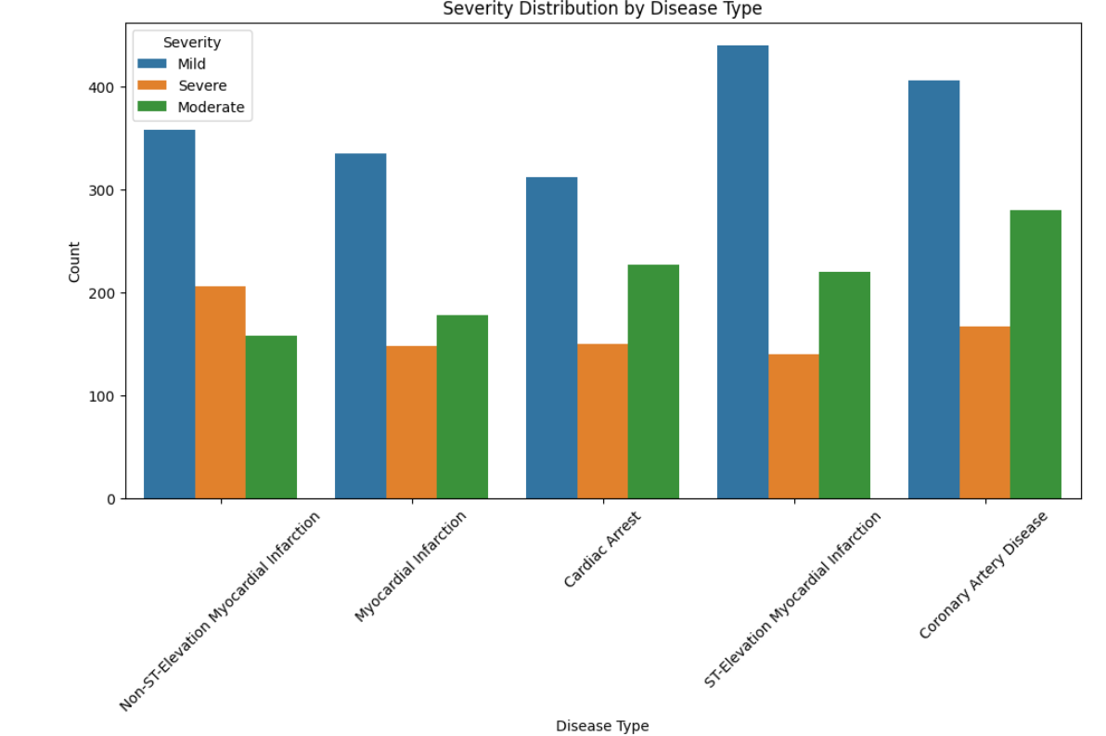
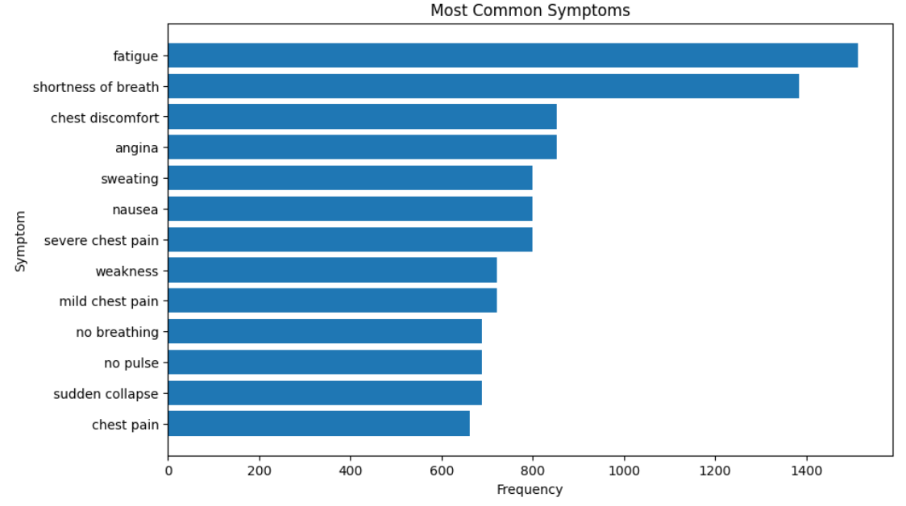
Joint Analysis: Diagnoses + Lab Results

Slide 13
Feedback for Training Program
The Summer Bootcamp Training Program was a highly enriching and insightful experience. Working on a real-world case study like Heart Disease Analysis in India helped me enhance both my technical and analytical skills.
The mentorship and guidance provided by our trainers played a crucial role in understanding industry-oriented workflows. The division of tasks helped us specialize in different areas such as Power BI, SQL analysis, Python-based insights, and data integration, fostering teamwork and ownership.
Overall, the bootcamp significantly strengthened my foundation in data analytics and project execution. It was a valuable step forward in preparing for future roles in data science and related domains.

Slide 14


